Slide 1
AN AUTOMATED MULTIPLE CHOICE QUESTIONS GENERATION USING NATURAL LANGUAGE PROCESSING

Slide 2
Introduction
We focus on the setting of MCQs through NLP to improve the method of setting MCQs and for creating a question bank that can be used by the academicians for their learners. This will ensure an MCQ that includes appropriate questions and options based on the learning objectives and importance of the topics.

Slide 3
Abstract
Examinations and Assessments are undergoing a tremendous revolution. Universities, colleges, and othereducational institutes are increasingly shifting towards online examinations. The pattern of assessment is majorly shifting towards the objective assessment i.e. MCQ based, it is very hard to construct and requires a considerable amount of time for setting numerous questions. There’s a growing need for a cost effective and time-efficient automated MCQ generation system. In this project the text is first summarized using the BERT algorithm, and accordingly sentence mapping is done for generating MCQs. In order to generate choices for the questions, distractors are generated using word net (A lexical database for English). As the BERT algorithm has much better performance over other legacy methods as well as it can process a large amount of data in less time, it will enhance the speed of generating MCQs from given text.

Slide 4
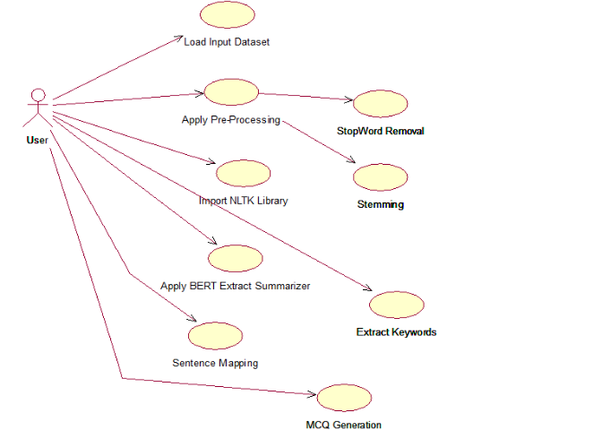
design
Use Case:

Slide 5
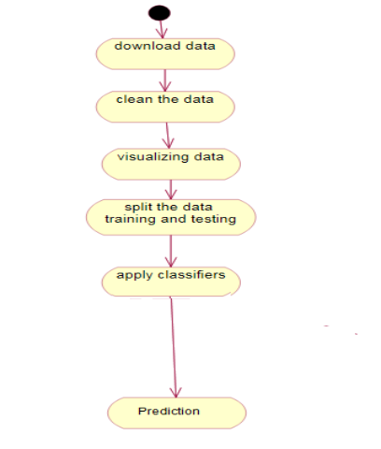
Activity:

Slide 6
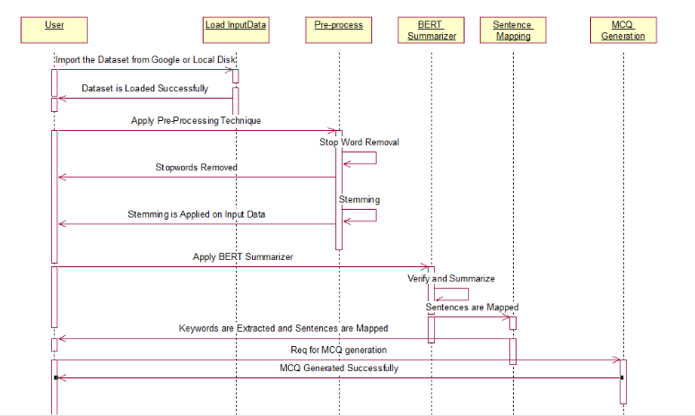
Sequence:

Slide 7
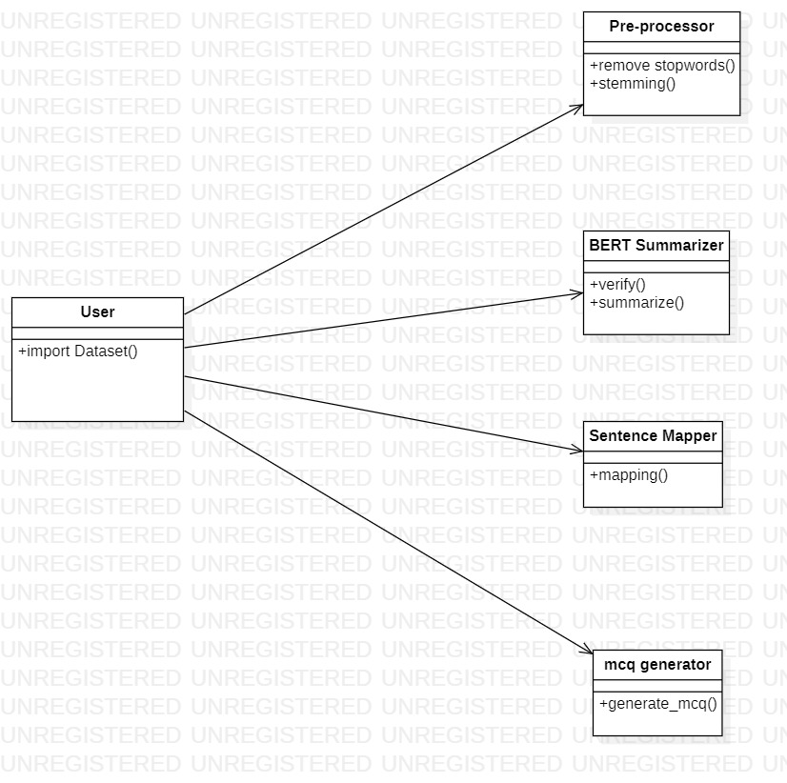
Class Diagram:

Slide 8

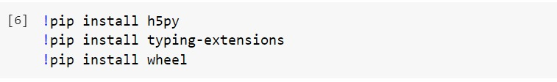
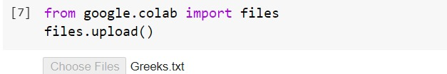
Implementation

Slide 9
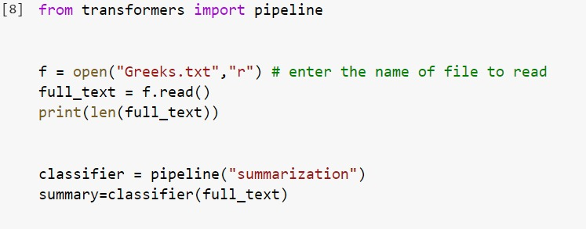
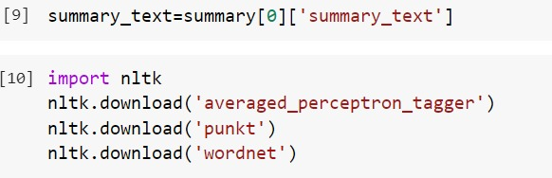

Slide 10
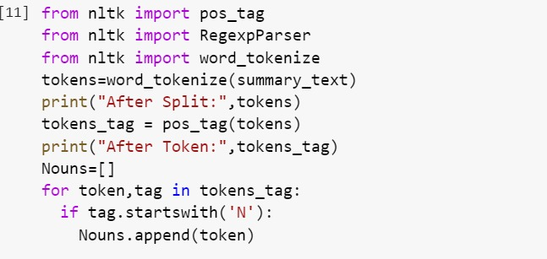

Slide 11
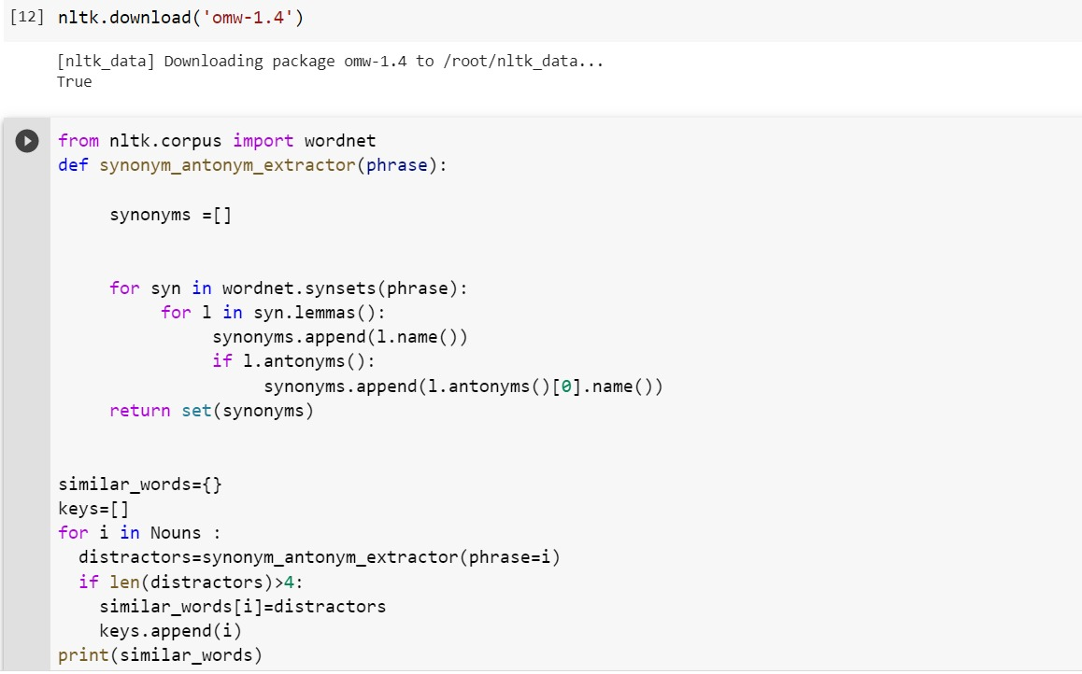

Slide 12
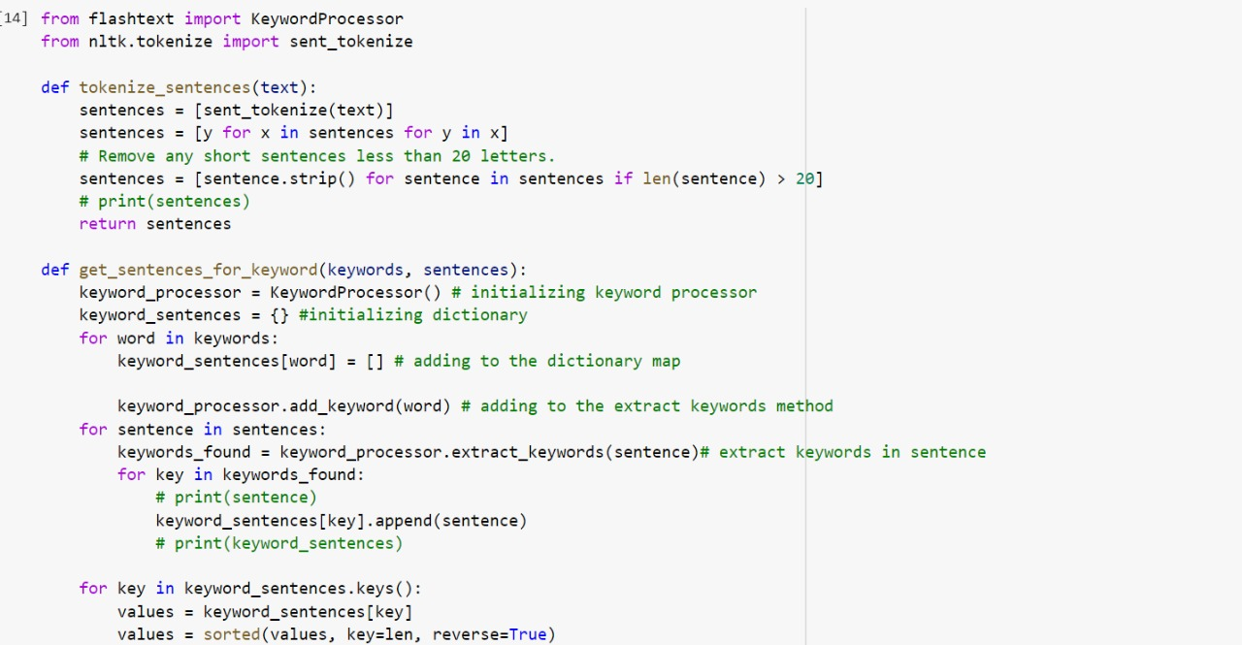
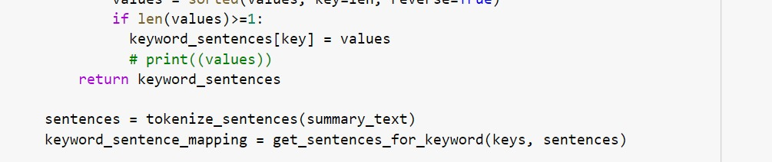

Slide 13
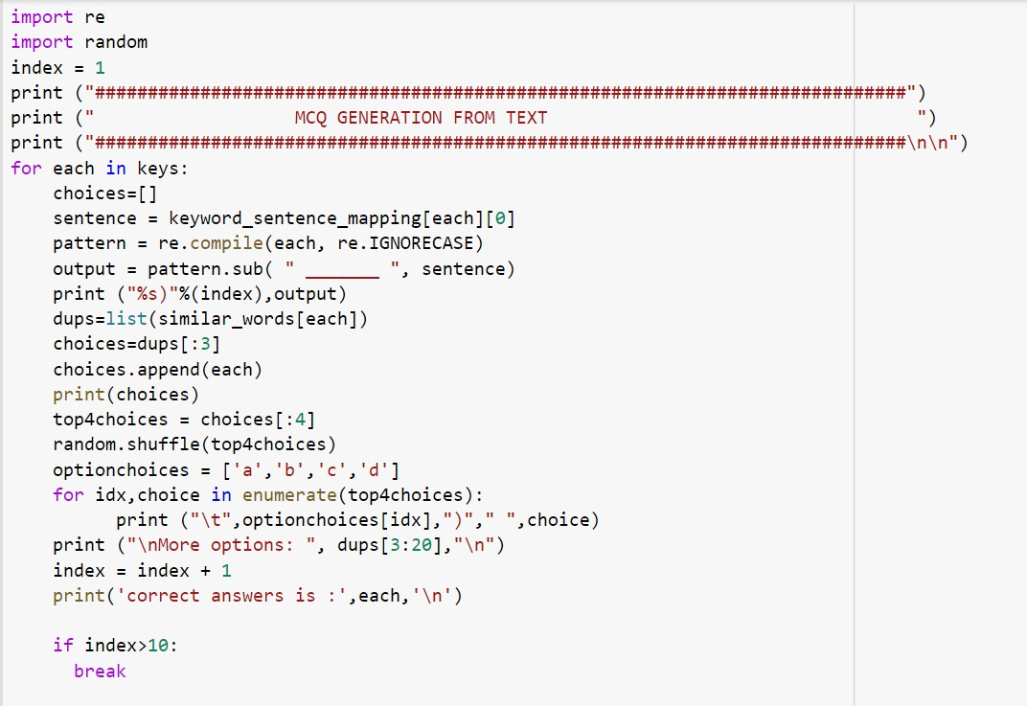

Slide 14
Test Case
Test case is a text file.
The Greek historian knew what he was talking about. The Nile River fed Egyptian civilization for hundreds of years. The Longest River the Nile is 4,160 miles long—the world’s longest river. It begins near the equator in Africa and flows north to the Mediterranean Sea. In the south the Nile churns with cataracts. A cataract is a waterfall. Near the sea the Nile branches into a delta. A delta is an area near a river’s mouth where the water deposits fine soil called silt. In the delta, the Nile divides into many streams. The river is called the upper Nile in the south and the lower Nile in the north. For centuries, heavy rains in Ethiopia caused the Nile to flood every summer. The floods deposited rich soil along the Nile’s shores. This soil was fertile, which means it was good for growing crops. Unlike the Tigris and Euphrates, the Nile River flooded at the same time every year, so farmers could predict when to plant their crops. Red Land, Black Land The ancient Egyptians lived in narrow bands of land on each side of the Nile. They called this region the black land because of the fertile soil that the floods deposited. The red land was the barren desert beyond the fertile region. Weather in Egypt was almost always the same. Eight months of the year were sunny and hot. The four months of winter were sunny but cooler. Most of the region received only an inch of rain a year. The parts of Egypt not near the Nile were a desert. Isolation The harsh desert acted as a barrier to keep out enemies. The Mediterranean coast was swampy and lacked good harbors. For these reasons, early Egyptians stayed close to home. Each year, Egyptian farmers watched for white birds called ibises, which flew up from the south. When the birds arrived, the annual flood waters would soon follow. After the waters drained away, farmers could plant seeds in the fertile soil. Agricultural Techniques By about 2400 B.C., farmers used technology to expand their farmland. Working together, they dug irrigation canals that carried river water to dry areas. Then they used a tool called a shaduf to spread the water across the fields. These innovative, or new, techniques gave them more farmland. Egyptian Crops Ancient Egyptians grew a large variety of foods. They were the first to grind wheat into flour and to mix the flour with yeast and water to make dough rise into bread. They grew vegetables such as lettuce, radishes, asparagus, and cucumbers. Fruits included dates, figs, grapes, and watermelons. Egyptians also grew the materials for their clothes. They were the first to weave fibers from flax plants into a fabric called linen. Lightweight linen cloth was perfect for hot Egyptian days. Men wore linen wraps around their waists. Women wore loose, sleeveless dresses. Egyptians also wove marsh grasses into sandals. Egyptian Houses Egyptians built houses using bricks made of mud from the Nile mixed with chopped straw. They placed narrow windows high in the walls to reduce bright sunlight. Egyptians often painted walls white to reflect the blazing heat. They wove sticks and palm trees to make roofs. Inside, woven reed mats covered the dirt floor. Most Egyptians slept on mats covered with linen sheets. Wealthy citizens enjoyed bed frames and cushions. Egyptian nobles had fancier homes with tree-lined courtyards for shade. Some had a pool filled with lotus blossoms and fish. Poorer Egyptians simply went to the roof to cool off after sunset. They often cooked, ate, and even slept outside. Egypt’s economy depended on farming. However, the natural resources of the area allowed other economic activities to develop too. The Egyptians wanted valuable metals that were not found in the black land. For example, they wanted copper to make tools and weapons. Egyptians looked for copper as early as 6000 B.C.

